Slide 1
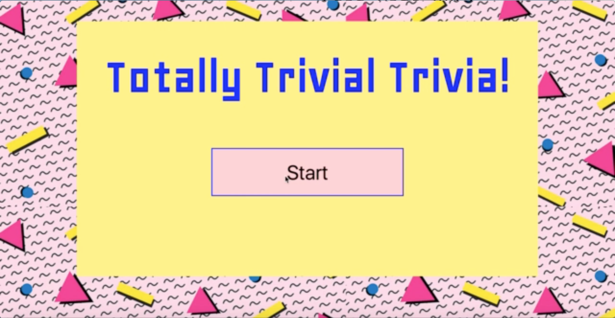
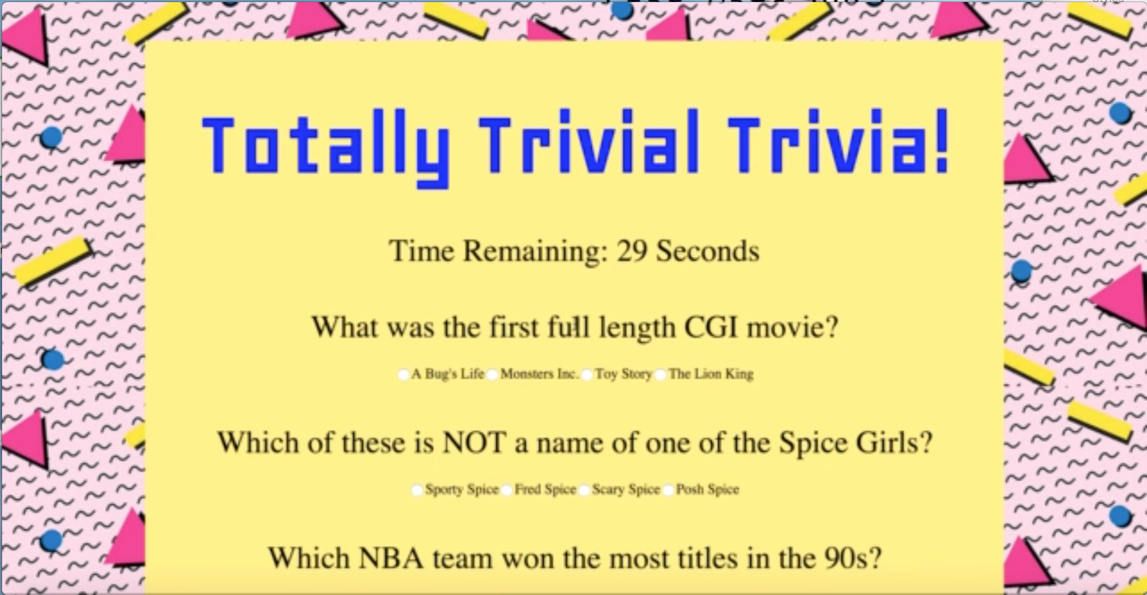
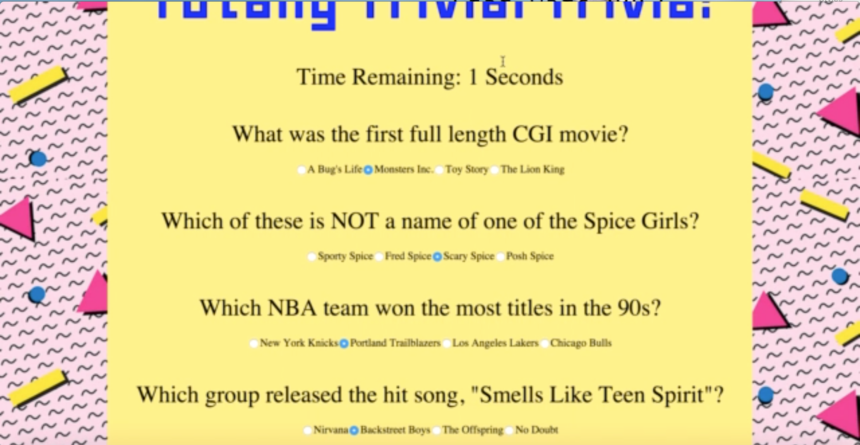
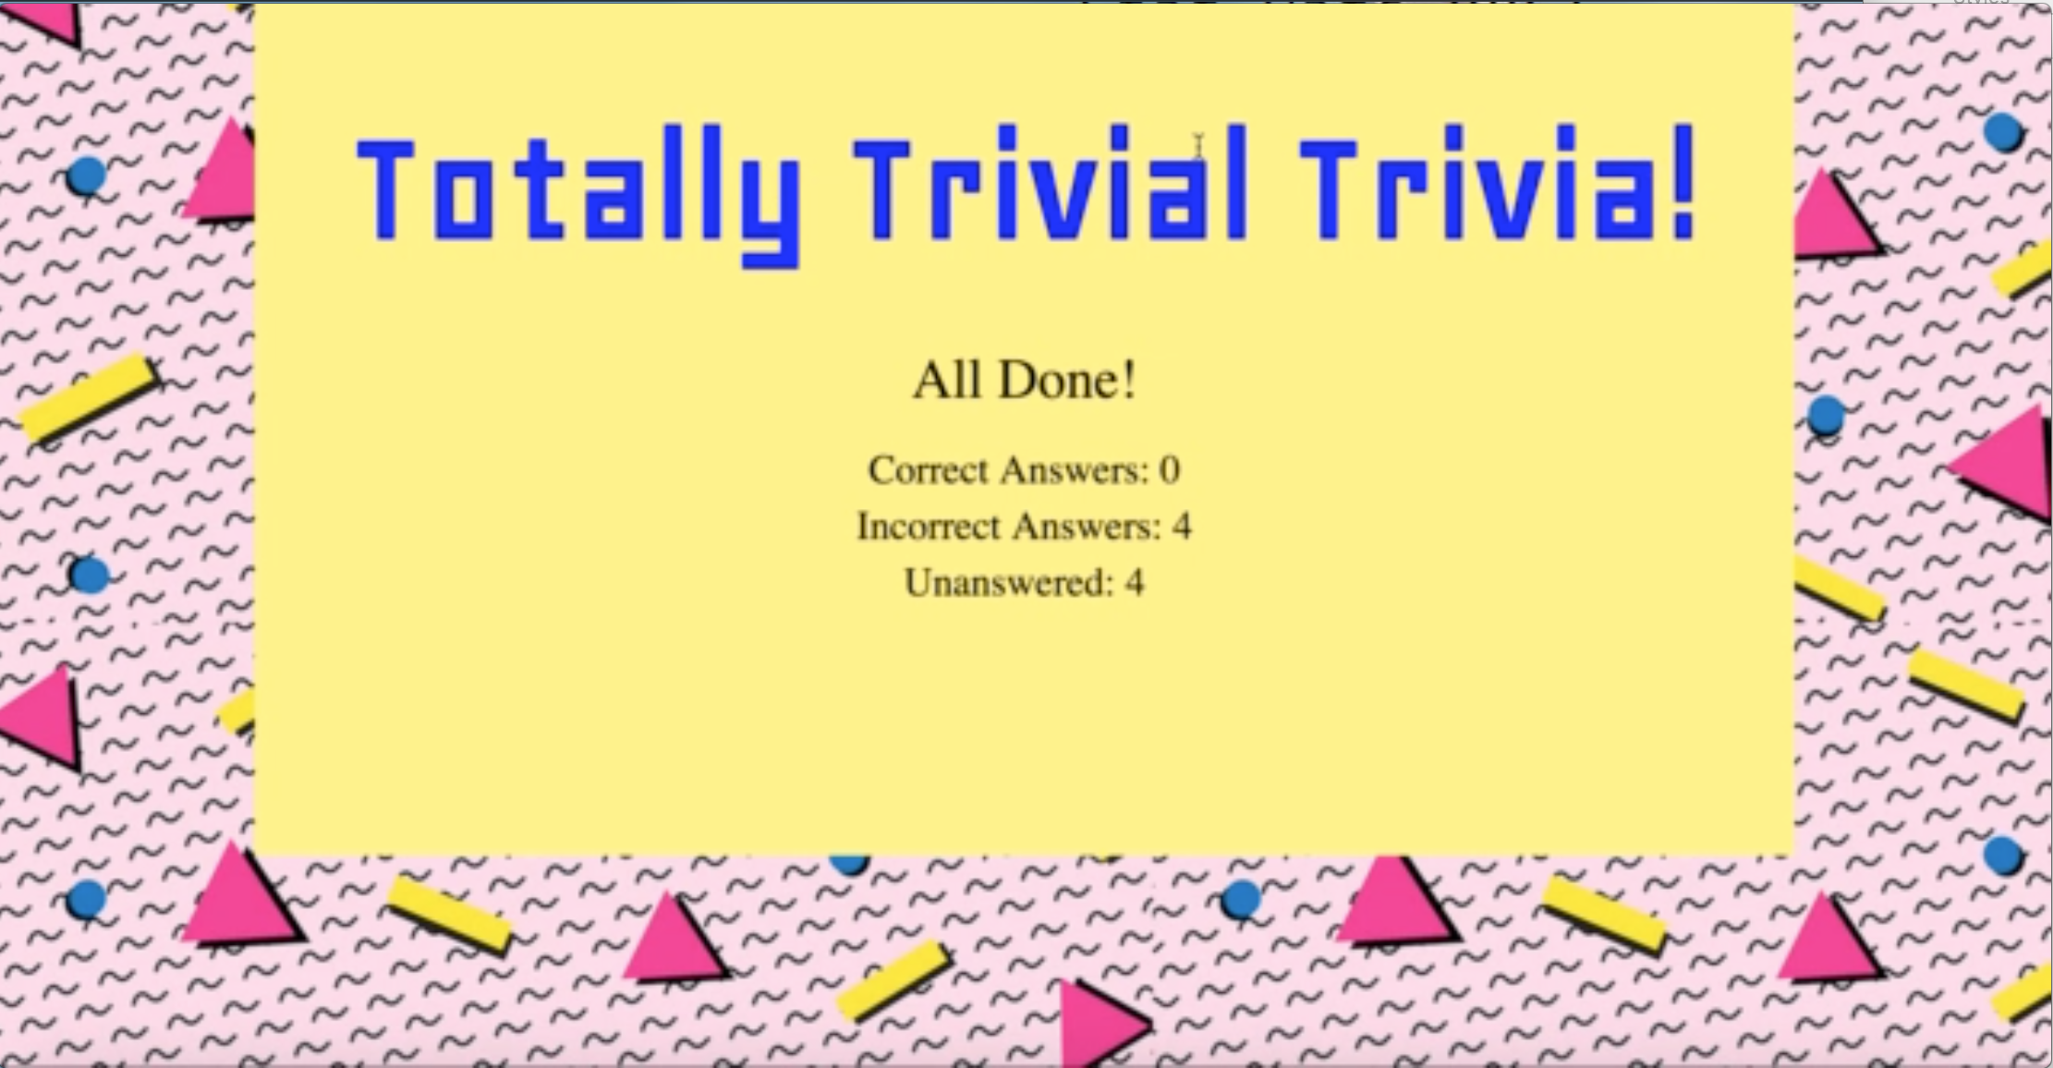
Basic Trivia Game Screens
1- Start Screen
2 - Press Start
4 – Time’s Up
3 - Play Game / Scroll Down
NOTE: Screens 4&5 are the same whether from the timeout or user clicks ”Done”.
5 – Done Screen

Slide 2
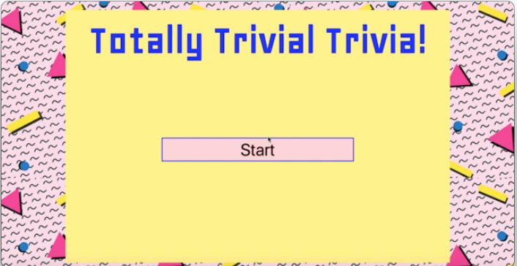
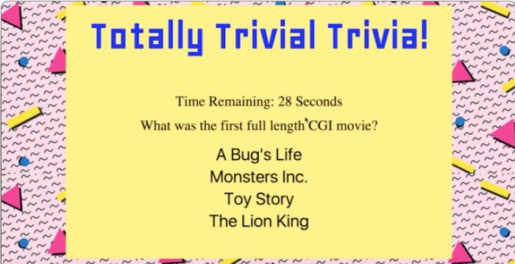
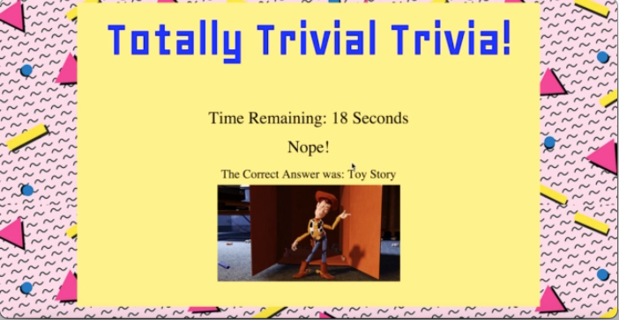
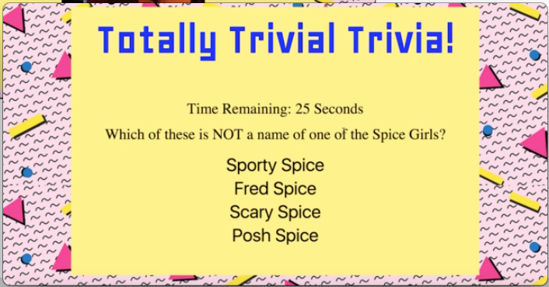
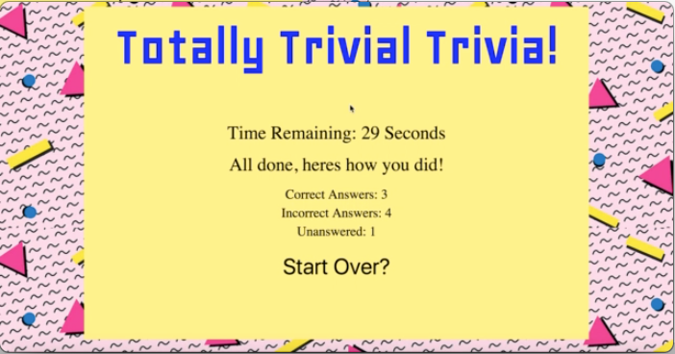
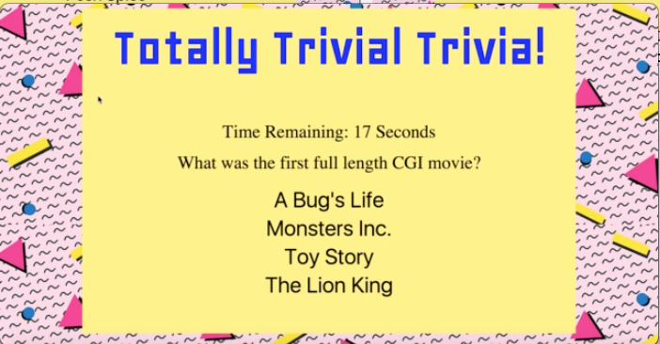
1 – Start Screen
2 – Play Game
3 – Question Answered
4 – Play Game
5 – Start Over?
6 – Start Over Clicked
NOTE: 4 – Play Game continues the play automatically w/o user input. The timer is reset for the next question. Also, this Play Game is the same as 2 so screens 2&3 are repeated until the end at which point screen 5 is displayed.
NOTE: 5 – Start Over? Is a button. When Clicked, the game is started from the beginning. It is NOT reloaded/refreshed.
Advanced Trivia Game Screens

